Slide 1


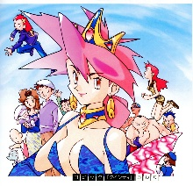
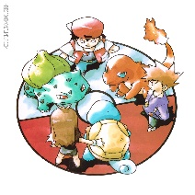
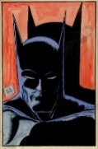
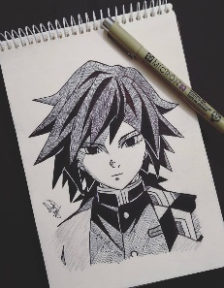
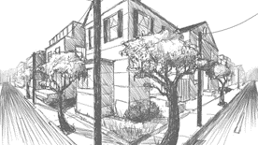
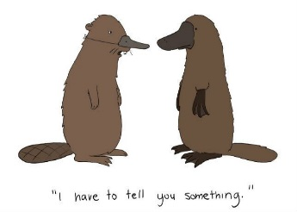
Spring Trust Academy – Knowledge Organiser
Art Focus | Drawing | Year 6
Who? Focus Famous Artist
Ken Sugimorii | Ken Sugimori (born January 27, 1966 in Tokyo, Japan) is a Japanese video game designer, illustrator, manga artist, and director. He is most famous as the character designer and art director for the Pokémon franchise. Sugimori is most famous as the character designer and art director for the Pokémon franchise and drew all of the original 151 Pokémon himself. He drew much of his inspiration from observing animals in aquariums and zoos. Sugimori has also written and illustrated original manga. When he begins a new character, his process normally involves making a rough sketch, then tracing it on to film paper while polishing it and making the illustration more professional looking. After that, he draws the character many times, changing its proportions until he is satisfied.
Who? Additional Artists
Bob Kane | Creator of Batman; writer and illustrator for DC Marvel Comics
What? Key vocab
Illustrator | Draws/ creates pictures for various publications.
Cartoonist | Draws cartoons
Manga | A style of Japanese comic book
Viewfinder | Used to frame/ focus on a picture/or part of
Dimension | 3d aspects of something
Perspective | Giving a 3d impression on a 2d surface
Proportion | The relationship of one thing to another in terms of quantity etc.
Frame | Rigid structure that surrounds a picture
Distance | The length of space between two points
What? Key Skills
To choose a style of drawing, select media and use a range of techniques for a specific purpose. To use a range of techniques to show movement, perspective, shadows and reflection. To draw from different viewpoints.
Pictures and Diagrams

