Slide 1

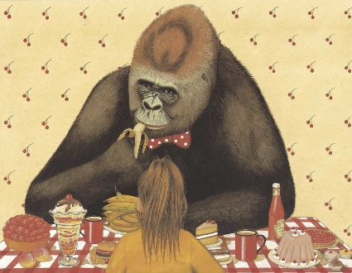
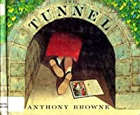
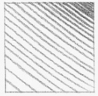
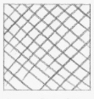
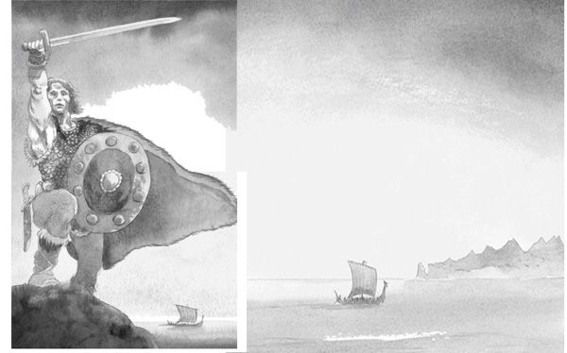
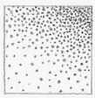
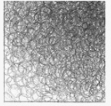
Spring Trust Academy – Knowledge Organiser
Art Focus | Drawing | Year 5
Key vocab
Shape | 2D, created by joining lines.
Form | 3D effect using shading.
Value | How light or dark a shade is.
Proportion | The relationship of one thing to another in terms of quantity etc.
Gradient | The transition from light to dark
Light source | Where light appears to shine in a picture.
Texture | How the object would feel, rough, smooth etc.
Shading | A technique used by artists to create the illusion of depth
What? Key Skills
To choose a style of drawing, select media and use a range of techniques for a specific purpose. To use a range of techniques to show movement, perspective, shadows and reflection. To draw from different viewpoints.
Who? Focus Famous Artist
Anthony Browne | British illustrator and author Some of his most famous books are: Gorilla, The Tunnel, Look What I’ve Got. He
Drawing techniques
Hatching
Cross Hatching
Stippling
Scumbling
Other Artists
Michael Foreman Illustrator of Beowulf and Stubby.

