Slide 1

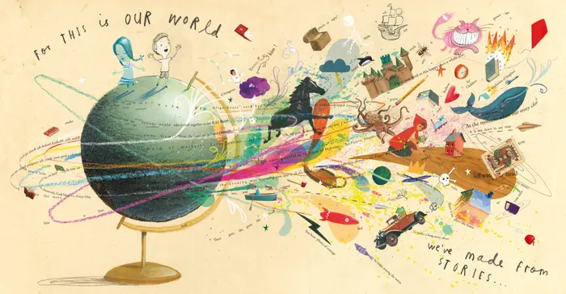
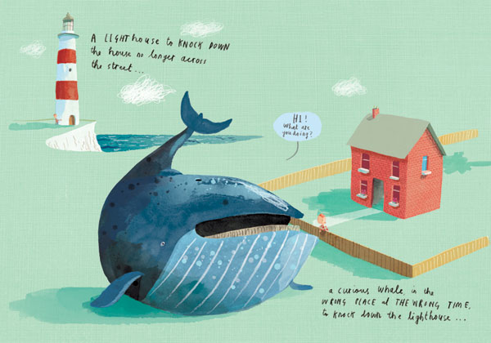
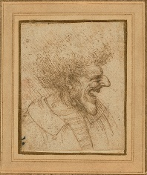
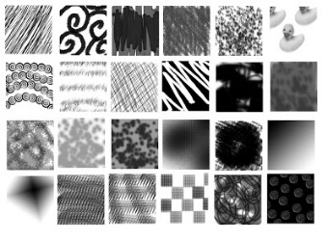
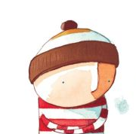
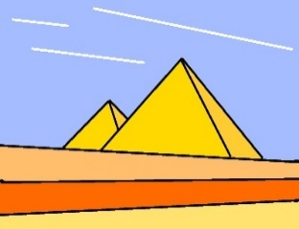
Spring Trust Academy – Knowledge Organiser
Art Focus | Drawing | Year 4
Who? Focus Famous Artist
Oliver Jeffers | Illustrator of famous children’s books (How to catch and star, Lost and found and Stuck) Born in Belfast, Northern Ireland in 1977. Loved drawing at school. He graduates from the University of Ulster in 2001. Here is a list of books that Oliver has illustrated: The Day the Crayons Quit, How to Catch a Star, Lost and Found, The Way Back Home, Up and Down, Oliver Jeffers presents the Incredible Book Eating Boy, the Great Paper Caper, The Heart and the Bottle, Stuck, This Moose Belongs To Me, The Hueys in The New Jumper, The Hueys in It Wasn't Me, The Hueys in None the Number (A counting Adventure,) Once Upon an Alphabet (Short stories For all the Letters.)
Who? Additional Artists
Leonardo da Vinci | Using hatching. Leonardo da Vinci used a drawing technique called “hatching”. Hatching consists of straight or curved lines drawn close to each other to give the illusion of value. Da Vinci was left-handed, and his hatching lines went from the upper left down to the lower right.
What? Key vocab
Repeat | Something that happens again and again
Echo | A repetition or mimicking of something
Effective | Successful in producing a desired result
Illustrator | A person who draws for books and more.
Shadow | A dark area produced by something coming between the light and the surface
Media | Materials that are used to create a work of art
Pattern | A repeated decorative design
Hatching | A technique used to create shading used equally spaces parallel lines
What? Key Skills
To use pencils with different hardness to show line, tone and texture. To use shading to show light and shadow. To use hatching to show tone and texture.
Pictures and Diagrams

