Slide 1

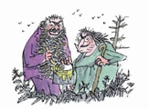
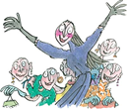
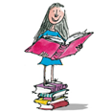
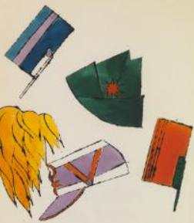
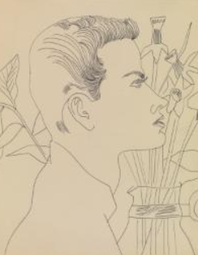
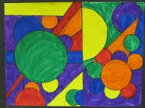
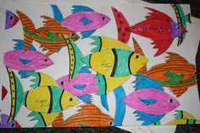
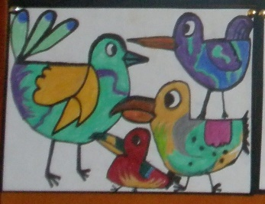
Spring Trust Academy – Knowledge Organiser
Art Focus | Drawing | Year 3
Who? Focus Famous Artist
Quentin Blake | Quentin Blake was born in the suburbs of London in 1932 and has drawn ever since he can remember. He went to Chislehurst and Sidcup Grammar School, followed by National Service. Then he studied English at Downing College, Cambridge, going on to do a postgraduate teaching diploma at the University of London, followed by life-classes at Chelsea Art School. He has always made a living as an illustrator. He is known for his collaboration with writers such as Russell Hoban, Joan Aiken, Michael Rosen, John Yeoman and, most famously, Roald Dahl.
Who? Additional Artists
Andy Warhol | He created drawings using a type of line drawing known as the blotted line technique. Warhol began by copying a line drawing in pencil on a piece of non-absorbent paper, such as tracing paper. Next, he hinged this piece of paper to a second sheet of more absorbent paper by taping their edges together on one side. With a fountain pen, Warhol inked over a small section of the drawn lines. He then transferred the ink onto the second sheet by folding along the hinge and lightly pressing or “blotting” the two papers together.
What? Key vocab
Overlap | Extends over so it covers something partly.
2D shapes | A shape with only two dimensions, such as width and height but no thickness
Foreground | The part of the picture that appears closest to the viewer
Middeground | The part of the picture between both the foreground and background
Background | The part of the picture that appears the furthest from the viewer.
Illustrator | A person who draws or creates pictures for magazines, books, advertising, etc
Shading | A technique used by artists to create the illusion of depth
What? Key Skills
To use different hardnesses of pencils to show line, tone and texture. To use shading to show light and shadow. To select and arrange materials for a purpose. To use a viewfinder to focus on a specific part of an artefact.
Pictures and Diagrams

