Slide 1

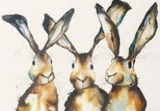
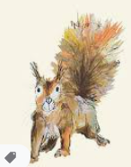
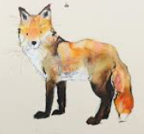
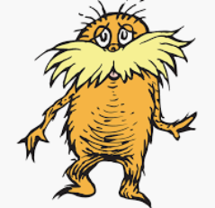
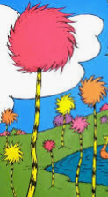
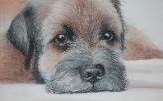
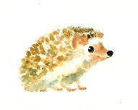
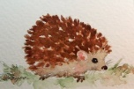
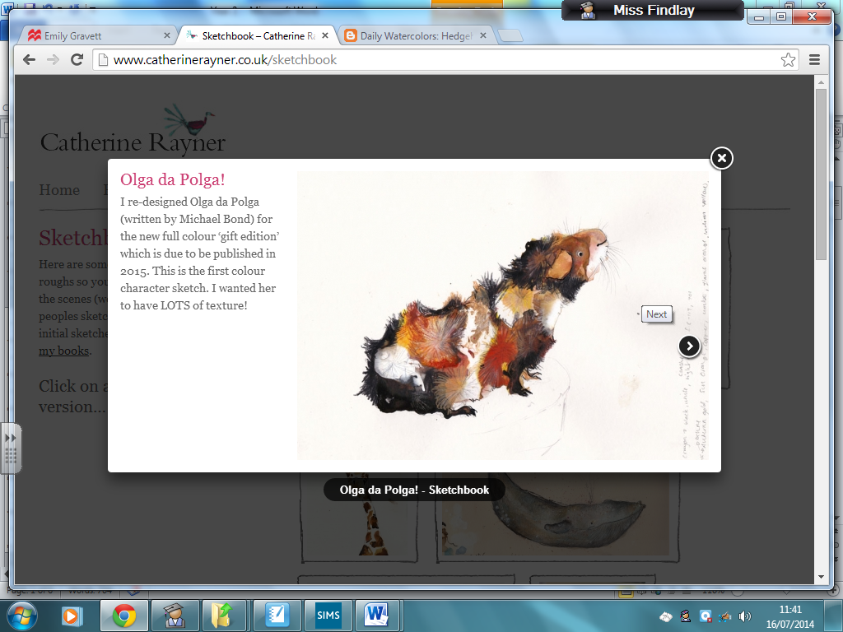
Spring Trust Academy – Knowledge Organiser
Art Focus | Drawing | Year 2
Who? Focus Famous Artist
Catherine Rayner | Illustrator and write of famous children’s books Born in Harrogate in 1982 Studied at Leeds College of Art and Edinburgh College of Art. She won the Kate Greenaway Medal in 2009 for Harris Finds his Feet, and has been shortlisted in 2007, 2011, 2012, 2015. In 2014, Norris, The Bear Who Shared was named by The Sunday Times as one of the 100 Children's Modern Classics of the past ten years. Rayner employs the use of subtle colour and tone whilst playing with scale, composition and open space within in her drawing. Her creatures are brought to life using spontaneous and vivacious line that explores movement and personality.
Who? Additional Artists
Dr Suess | He was an American writer and cartoonist from Springfield, Massachusetts. He was better known by his pen name, Dr. Seuss. Notable work(s): The Cat in the Hat, Green Eggs and Ham, The Grinch His favored medium is watercolor, usually either on bristol or illustration board. He also makes ample use of ink or pen, oil, and acrylic. This selection of media helps to expand his distinctive style.
What? Key vocab
Texture | What things are made of and how they feel – for example ‘gritty’ ‘soft’ or ‘smooth’
Detail | Small pieces of information
Image | A representation of a something drawn
Illustration | A picture or diagram that explains or decorates
Fine | Very thin or narrow
Pattern | A repeated decorative design
What? Key Skills
To draw images from observation, experience and imagination. To use a range of materials, including pencils, chalk, charcoal, pastels, etc. To develop their use of space, composition and proportion. To use different techniques to create pattern, tone and texture.
Pictures and Diagrams

